Slide 1

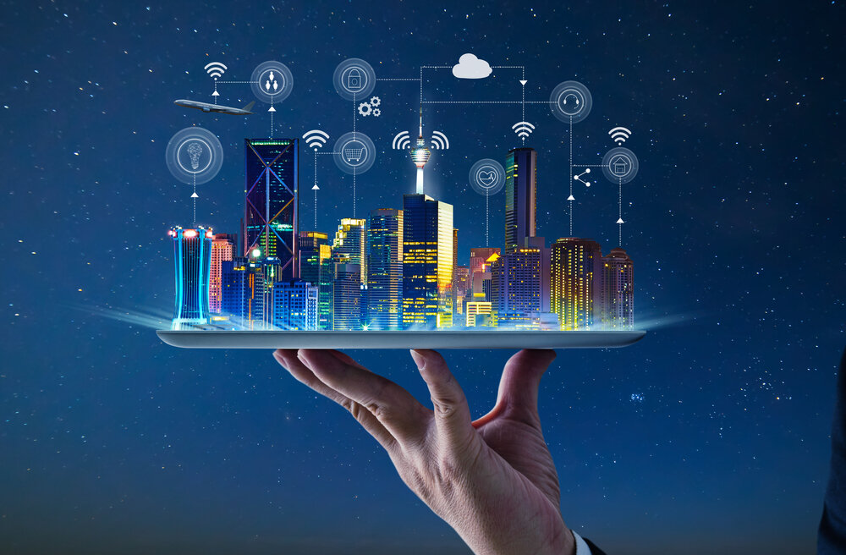
Internet of Things
(IoT)

Slide 2
Internet of Things(IoT) - Syllabus
UNIT – 1 :- FUNDAMENTALS OF IoT
Evolution of Internet of Things, Enabling Technologies, IoT Architectures, oneM2M, IoT World Forum (IoT-WF) and Alternative IoT models, Simplified IoT Architecture and Core IoT Functional Stack, Fog, Edge and Cloud in IoT, Functional blocks of an IoT ecosystem, Sensors, Actuators, & Smart Objects.
IoT Platfortri overview: Overview of IoT supported Hardware platforms such as: ARM Cortex Processors, Arduino and Intel Galileo boards.
Lecture Details:
Fundamentals Of IoT
Branch: CSM
Semester: III-II

Slide 3
Internet of Things(IoT) - Syllabus
UNIT – 2 :- IoT COMMUNICATION PROTOCOLS
Access Technologies: Physical and MAC layers, topology and Security of IEEE 802.15.4, 802.15.49, 802.15.4e, 802.11ah and Lora WAN, Network Layer: IP versions, Constrained Nodes and Constrained Networks, Application Transport Methods: Supervisory Control and Data Acquisition, Application Layer Protocols: CoAP and MQTT.
Lecture Details:
Fundamentals Of IoT
Branch: CSM
Semester: III-II

Slide 4
Internet of Things(IoT) - Syllabus
UNIT – 3 :- DESIGN AND DEVELOPMENT ENVIRONMENT
Design Methodology, Embedded computing logic, Microcontroller, System on Chips, IoT system building blocks, Arduino, Nodemcu Board details, IDE programming.
UNIT – 4 :- DATAANALYTICS AND SERVICES
Structured Vs Unstructured Data and Data in Motion Vs Data in Rest, Role of Machine Learning — No SQL Databases, HadoopEcosystem, Apache Kafka, Apache Spark, Edge Streaming Analytics, Xively Cloud for IoT, Python Web Application.

Slide 5
Internet of Things(IoT) - Syllabus
UNIT – 5 :- CASE STUDIES/INDUSTRIAL APPLICATIONS
IoT applications in home, Agriculture 3.0, buildings, security, Industries, Home appliances, other IoT electronic equipment's. Use of Big Data and Visualization in IoT.
Lecture Details:
Fundamentals Of IoT
Branch: CSM
Semester: III-II

Slide 6
Evolution of Internet of Things, Enabling Technologies, IoT Architectures, oneM2M, IoT World Forum (IoT-WF) and Alternative IoT models, Simplified IoT Architecture and Core IoT Functional Stack, Fog, Edge and Cloud in IoT, Functional blocks of an IoT ecosystem, Sensors, Actuators, & Smart Objects .
IoT Platfortri overview: Overview of IoT supported Hardware platforms such as: ARM Cortex Processors, Arduino and Intel Galileo boards.
UNIT-1: Fundamentals of IoT
Presented By:
G S Charitha
Designation :Asst..Prof
Department: ECE
College:GIET(A)
Lecture Details:
Fundamentals Of IoT
Branch: Common to CS, CSE, CSM & CIVIL
Semester: III-II

Slide 7
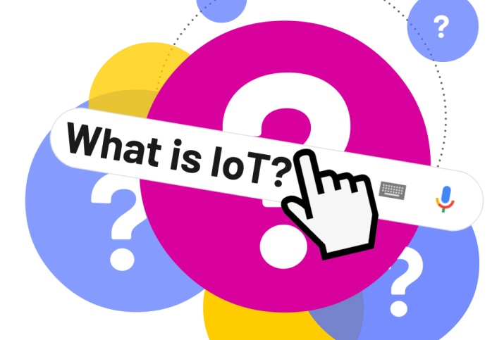
Definition:-The Internet of Things (IoT) is the network of physical objects or "things" embedded with electronics, software, sensors, and network connectivity, which enables these objects to collect and exchange data.
Lecture Details:
Fundamentals Of IOT
Branch: CSM
Semester: III-II

Slide 8
Cont..
Definition2:- The Internet of Things (IoT) refers to a system of interrelated, internet-connected objects that are able to collect and transfer data over a wireless network without human intervention
Lecture Details:
Fundamentals Of IOT
Branch: CSM
Semester: III-II

Slide 9

The term Internet of Things is 16 years old. But the actual idea of connected devices had been around longer, at least since the 70s. Back then, the idea was often called “embedded internet” or “pervasive computing”. But the actual term “Internet of Things” was coined by Kevin Ashton in 1999 during his work at Procter & Gamble. Ashton who was working in supply chain optimization, wanted to attract senior management’s attention to a new exciting technology called RFID. Because the internet was the hottest new trend in 1999 and because it somehow made sense, he called his presentation “Internet of Things”.
History of IoT
Lecture Details:
Fundamentals Of IOT
Branch: CSM
Semester: III-II

Slide 10
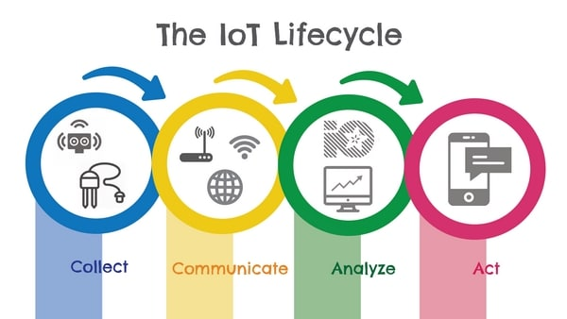
Life Cycle Of IoT
Lecture Details:
UNIT-1:- Fundamentals of IoT

Slide 11
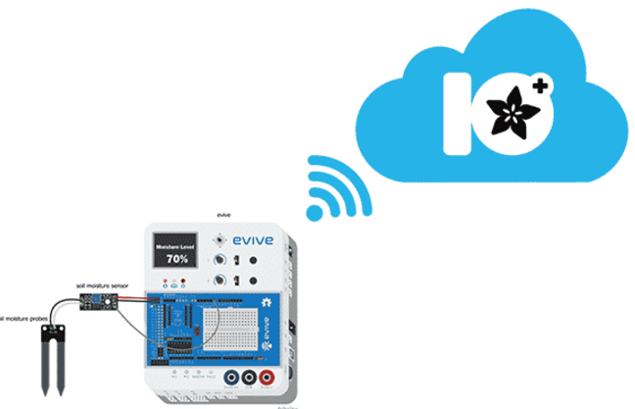
Cont..
Collection:- Device and Sensors are collecting the data every where
Ex:- At Home, In Your Car, At the office, In the manufacturing Plant
Communication:-The data collected from the sensors is then sent to the Internet to some destination with security and reliability. The devices like routers, switches, etc. are used to send data across the destination devices like a cloud platform like Google or Alexa, Home networks like Smart-home networks.
Lecture Details:
UNIT-1:- Fundamentals of IoT

Slide 12
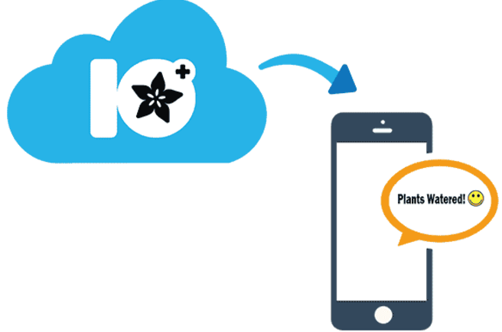
Cont..
Analyzing :- : In this Analysis phase, the data we collected needs to be analyzed to create a meaningful format.
Action:-Now that we have the final form of data we need to perform an action according to it.
Lecture Details:
UNIT-1:- Fundamentals of IoT

Slide 13
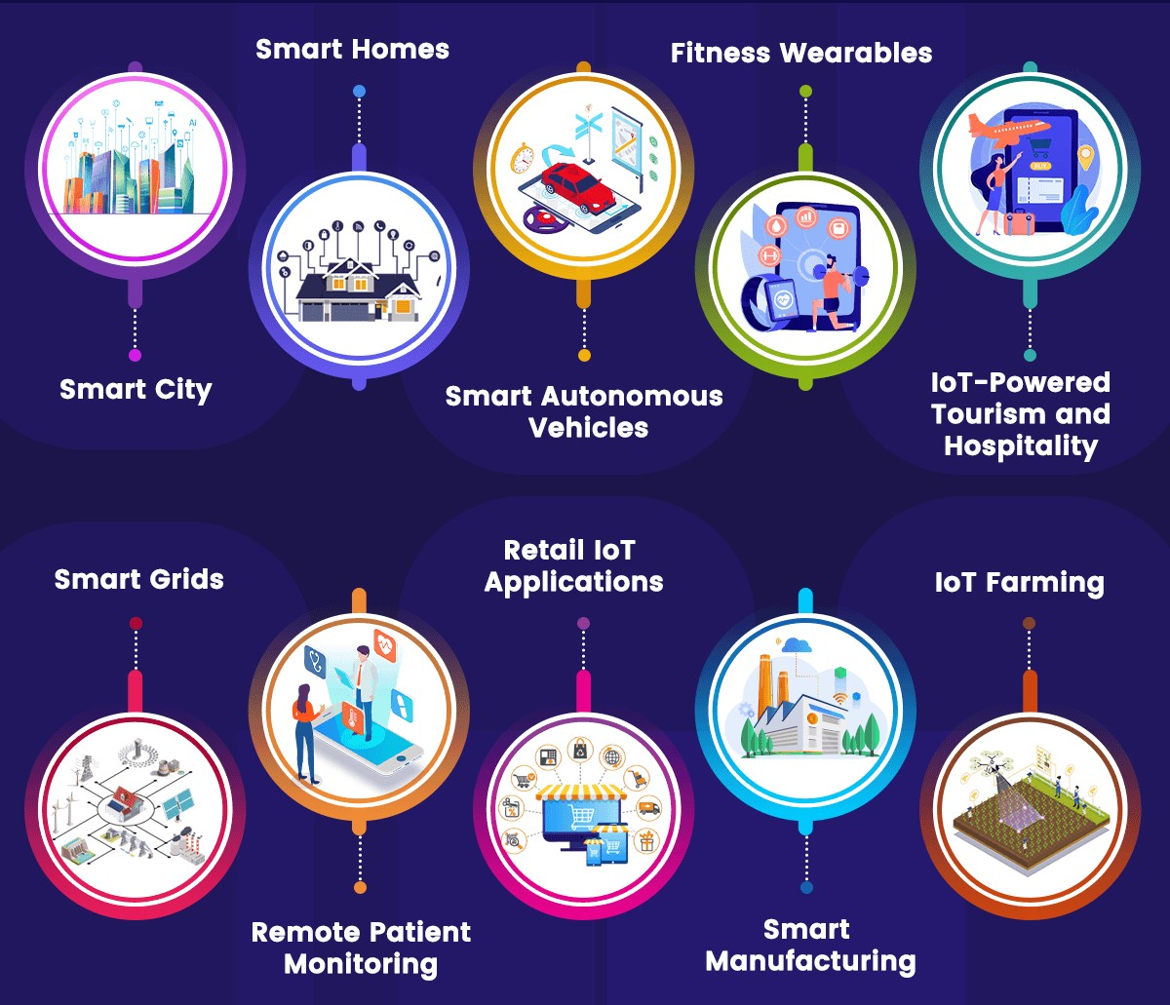
APPLICATIONS OF IoT
Lecture Details:
UNIT-1:- Fundamentals of IoT

Slide 14
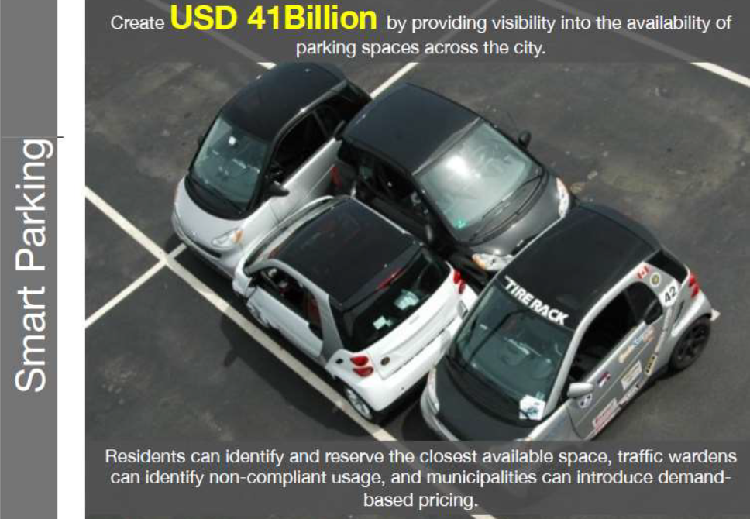
Cont..
Lecture Details:
UNIT-1:- Fundamentals of IoT

Slide 15
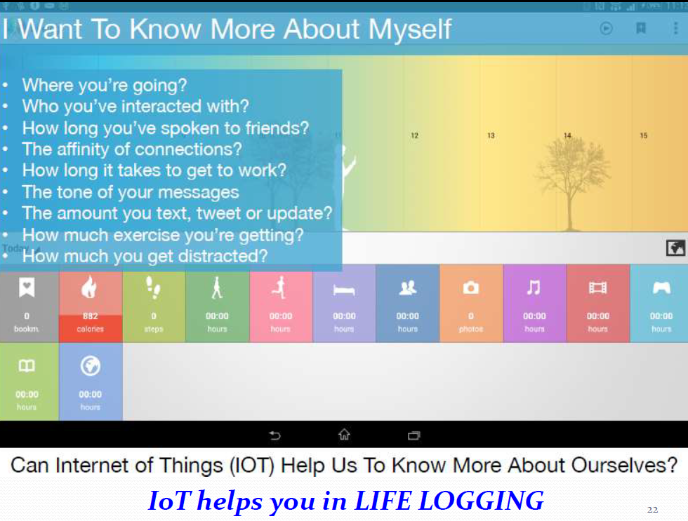
Cont..

Slide 16
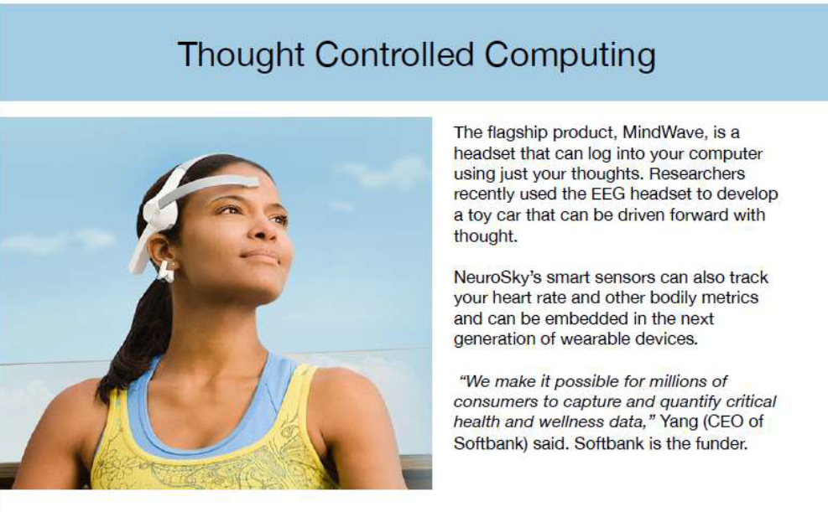
Cont..
Lecture Details:
UNIT-1:- Fundamentals of IoT

Slide 17
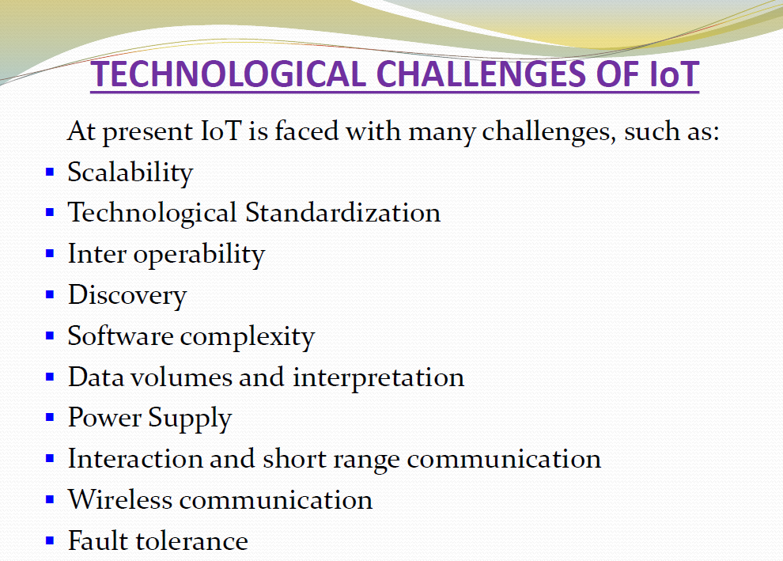
Cont..
Lecture Details:
UNIT-1:- Fundamentals of IoT

Slide 18
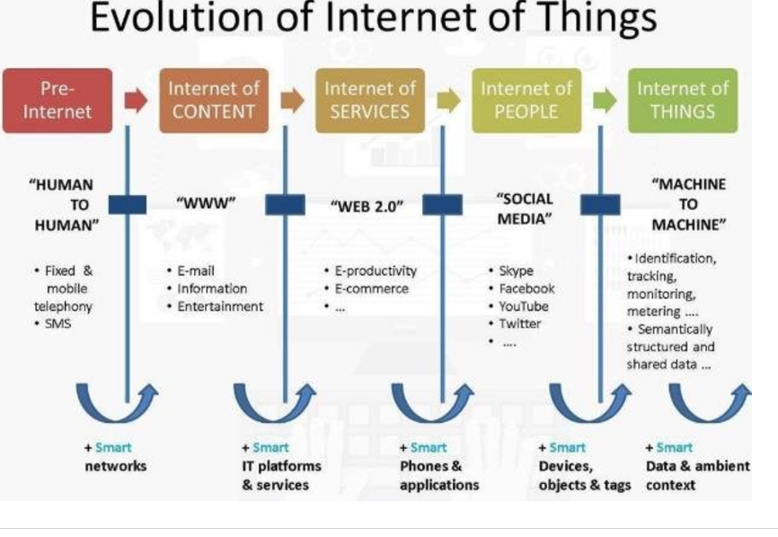
Cont..
Lecture Details:
UNIT-1:- Fundamentals of IoT

Slide 19
Cont..
Internet Phase | Defination
Connectivity (Digitize access) | This phase connected people to email, web services, and search so that information is easily accessed.
Networked Economy (Digitize business) | This phase enabled e-commerce and supply chain enhancements along with collaborative engagement to drive increased efficiency in business processes.
Immersive Experience (Digitize interactions) | This phase extended the Internet experience to encompass widespread video and social media while always being connected through mobility. More and more applications are moved into the cloud.
Internet of Things (Digitize the world) | This phase is adding connectivity to objects and machines in the world around us to enable new services and experiences. It is connecting the unconnected.
Lecture Details:
UNIT-1:- Fundamentals of IoT

Slide 20
Cont..
.
1.1960s- 1970s: Early beginnings:
The concept of interconnected devices emerged with early computer networks like ARPANET. While these networks weren’t “things” as we think of them today, they laid the foundation for connecting devices over large distances.
2.1980s- 1990s: Conceptualization and first IoT –like devices:
As computers became smaller and cheaper, researchers began exploring ways to connect devices outside of standard computers. A notable early example is the “Coke Machine” at Carnegie Mellon University, which became the first internet-connected appliance, allowing users to check if drinks were available and cold.
3.Late 1990s: IoT Concept emerges:
The term “Internet of things” was coined by “Kelvin Ashton” in 1999 while working on RFID(Radio Frequency identification) for supply chain optimization. The concept began to hold with RFID being used in logistics and inventory tracking, showing that everyday objects could communicate also.
Lecture Details:
UNIT-1:- Fundamentals of IoT

Slide 21
Cont..
.
4.2000s: Expansion of wireless and mobile technologies:
Wireless technologies like Wi-Fi, bluetooth and mobile internet networks became mainstream, making it easier for devices to stay connected. The growth of smart phones and improvements in microprocessors also allowed more compact, connected devices.
5.2010s: IoT becomes mainstream:
With cloud computing, big data and 4G networks, IoT began expanding rapidly. Companies launched “smart homes” that connected to the internet. IoT also started seeing industrial applications for monitoring, automation, and predictive maintenance, leading to terms like Industrial IoT (IIOT) .
6.2020s: The era of 5G and edge computing:
The rollout of “5G networks” significantly increased data transfer speeds and reduced latency, allowing more real-time applications such as autonomous vehicles and telemedicine. “Edge computing” also emerged, allowing data processing closer to devices to minimize delays and increase efficiency .
Lecture Details:
UNIT-1:- Fundamentals of IoT

Slide 22
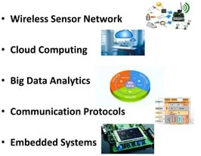
IoT ENABLING TECHNOLOGIES
IoT(internet of things) enabling technologies are
Lecture Details:
UNIT-1:- Fundamentals of IoT

Slide 23
Cont..
1. WIRELESS SENSOR NETWORK(WSN)
A WSN comprises distributed devices with sensors which are used to monitor the environmental and physical conditions.
A wireless sensor network consists of end nodes, routers and coordinators. End nodes have several sensors attached to them where the data is passed to a coordinator with the help of routers. The coordinator also acts as the gateway that connects WSN to the internet.
Examples:-Weather monitoring system, Indoor air quality monitoring system, Soil moisture monitoring system, Surveillance system, Health monitoring system
Lecture Details:
UNIT-1:- Fundamentals of IoT

Slide 24
Cont..
2. CLOUD COMPUTING
It provides us the means by which we can access applications as utilities over the internet. Cloud means something which is present in remote locations.
With Cloud computing, users can access any resources from anywhere like databases, webservers, storage, any device, and any software over the internet.
Characteristics
On demand self-services
2. Rapid scalability
3. Measured service
4. Pay-per-use
Lecture Details:
UNIT-1:- Fundamentals of IoT

Slide 25
Cont..
Cloud Computing Services
SaaS (Software as a service)
PaaS (Platform as a service)
IaaS (Infrastructure as a service)
SaaS (Software as a service)
It is a way of delivering applications over the internet as a service. Instead of installing and maintaining software, you simply access it via the internet, freeing yourself from complex software and hardware management.
Lecture Details:
UNIT-1:- Fundamentals of IoT

Slide 26
Cont..
SaaS Applications are sometimes called web-based software on demand software or hosted software. SaaS applications run on a SaaS provider’s service and they manage security availability and performance. Ex : Google Docs, Gmail, office etc.
PaaS (Platform as a service)
Provides a cloud-based environment with a very thing required to support the complete life cycle of building and delivering West web based (cloud) applications – without the cost and complexity of buying and managing underlying hardware, software provisioning and hosting.
Lecture Details:
UNIT-1:- Fundamentals of IoT

Slide 27
Cont..
Computing platforms such as hardware, operating systems and libraries etc. Basically, it provides a platform to develop applications. Ex : App Cloud, Google app engine
IaaS (Infrastructure as a service)
Infrastructure as a service provides online services such as physical machines, virtual machines, servers, networking, storage and data center space on a pay per use basis. Major IaaS providers are Google Compute Engine, Amazon Web Services and Microsoft Azure etc. Ex : Web Hosting, Virtual Machine etc.
Lecture Details:
UNIT-1:- Fundamentals of IoT

Slide 28
Cont..
3. BIG DATA ANALYTICS
It refers to the method of studying massive volumes of data or big data. Collection of data whose volume, velocity or variety is simply too massive and tough to store, control, process and examine the data using traditional databases. Big data is gathered from a variety of sources including social network videos, digital images, sensors and sales transaction records.
Several steps involved in analyzing big data –
1. Data Cleaning
2. Munging
3. Processing
4. Visualization
Lecture Details:
UNIT-1:- Fundamentals of IoT

Slide 29
Cont..
Examples –
Bank transactions
Data generated by IoT systems for location and tracking of vehicles
E-commerce and in Big-Basket
Health and fitness data generated by IoT system such as a fitness bands
Lecture Details:
UNIT-1:- Fundamentals of IoT

Slide 30
Cont..
4. COMMUNICATIONS PROTOCOLS
They are the backbone of IoT systems and enable network connectivity and linking to applications. Communication protocols allow devices to exchange data over the network. Multiple protocols often describe different aspects of a single communication. A group of protocols designed to work together is known as a protocol suite; when implemented in software they are a protocol stack. They are used in
Data encoding
Addressing schemes
Lecture Details:
UNIT-1:- Fundamentals of IoT

Slide 31
Cont..
5. EMBEDDED SYSTEMS
It is a combination of hardware and software used to perform special tasks. It includes microcontroller and microprocessor memory, networking units (Ethernet Wi-Fi adapters), input output units (display keyword etc. ) and storage devices (flash memory).
It collects the data and sends it to the internet. Embedded systems used in
Examples –
Digital camera, DVD player, music player, Industrial robots, Wireless Routers etc.
Lecture Details:
UNIT-1:- Fundamentals of IoT

Slide 32
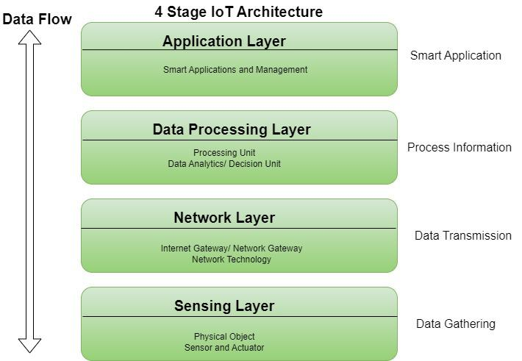
IoT ARCHITECTURE
Lecture Details:
UNIT-1:- Fundamentals of IoT

Slide 33
Cont..
1. SENSING LAYER
The sensing layer is the first layer of the Internet of Things architecture and is responsible for collecting data from different sources.
This layer includes sensors and actuators that are placed in the environment to gather information about temperature, humidity, light, sound, and other physical parameters. Wired or wireless communication protocols connect these devices to the network layer.
Lecture Details:
UNIT-1:- Fundamentals of IoT

Slide 34
Cont..
2. NETWORK LAYER
The network layer of an IoT architecture is responsible for providing communication and connectivity between devices in the IoT system.
Examples of network technologies that are commonly used in IoT include WiFi, Bluetooth, Zigbee, and cellular networks such as 4G and 5G technology
Additionally, the network layer may include gateways and routers that act as intermediaries between devices and the wider internet.
Security features such as encryption and authentication to protect against unauthorized access.
Lecture Details:
UNIT-1:- Fundamentals of IoT

Slide 35
Cont..
3. DATA PROCESSING LAYER
The data processing layer of IoT architecture refers to the software and hardware components that are responsible for collecting, analyzing, and interpreting data from IoT devices. T
This layer is responsible for receiving raw data from the devices, processing it, and making it available for further analysis or action.
The data processing layer includes a variety of technologies and tools, such as data management systems, analytics platforms, and machine learning algorithms. These tools are used to extract meaningful insights from the data and make decisions based on that data. Example of a technology used in the data processing layer is a data lake, which is a centralized repository for storing raw data from IoT devices.
Lecture Details:
UNIT-1:- Fundamentals of IoT

Slide 36
Cont..
4. APPLICATION LAYER
The application layer of IoT architecture is the topmost layer that interacts directly with the end-user.
It is responsible for providing user-friendly interfaces and functionalities that enable users to access and control IoT devices.
This layer includes various software and applications such as mobile apps, web portals, and other user interfaces that are designed to interact with the underlying IoT infrastructure.
The application layer also includes analytics and processing capabilities that allow data to be analyzed and transformed into meaningful insights. This can include machine learning algorithms, data visualization tools, and other advanced analytics capabilities.

Slide 37
oneM2M ARCHITECTURE
oneM2M standards allow any IoT application to discover and interact with any IoT device.
Machine to machine, or M2M, is a term that refers to systems in which machines interact with one another autonomously and without the need for human involvement, regardless of the devices or communication channels involved.

Slide 38
Cont..
M2M IoT architecture primarily focuses on IoT services, apps, and networks, facilitating their interoperability by providing a variety of application programming interfaces (APIs), allowing them to communicate with one another.
Application Layer
Service Layer
Network Layer
Fig:- oneM2M ARCHITECTURE

Slide 39
Cont..
Application Layer
It is the oneM2M architecture's top layer. IoT applications and services reside in this layer.
To access and manage IoT resources and data, the application layer communicates with the services layer.
The role of the IoT M2M Application Layer is to integrate IoT devices with apps, such as connecting smart devices to your phone. Additionally, it ensures that these gadgets can exchange data with other crucial systems, such as business intelligence tools.

Slide 40
Cont..
Services Layer
The service layer acts as a connecting layer between IoT devices and communication networks.
It is essential for abstracting away the difficulties of device connectivity and data transfer.
This layer standardizes data formats and communication protocols, providing interoperability across IoT platforms and devices. We can also say this layer functions as the background control hub. It manages the logical parts of the network and the rules they follow to work together efficiently.

Slide 41
Cont..
Network Layer
All devices, or "things," connect at the network layer. It also includes the physical network connections, such as cellular or Wi-Fi networks that link them.
The network layer manages the connectivity and data transmission between IoT devices.
It ensures that data is sent quickly and securely between devices, the cloud, and other data processing facilities.

Slide 42
Cont..
oneM2M ADVANTAGES
Modular Standardization
Vendor Independence
Lower costs
Interoperability

Slide 43
Cont..
IoT WORLD FORUM (IoT-WF) ARCHITECTURE
In 2014 the IoT-WF architectural committee (led by Cisco, IBM, Rockwell Automation, and others) published a seven-layer IoT architectural reference model.
Clean, simplified perspective on IoT and includes edge computing, data storage, and access

Slide 44
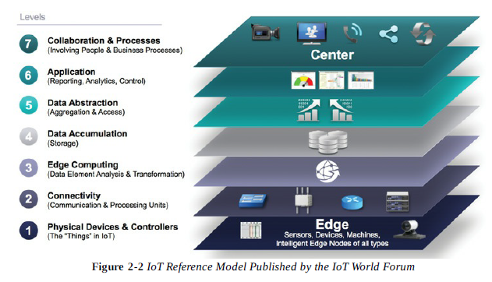
Cont..

Slide 45
Cont..
IoT WORLD FORUM (IoT-WF) ARCHITECTURE
Defines a set of levels with control flowing from the center (this could be either a cloud service or a dedicated data center), to the edge, which includes sensors, devices, machines, and other types of intelligent end nodes.
In general, data travels up the stack, originating from the edge, and goes northbound to the center.

Slide 46
Cont..
IoT WORLD FORUM (IoT-WF) ARCHITECTURE
Using this model, we are able to achieve:
Decompose the IoT problem into smaller parts
Identify different technologies at each layer and how they relate to one another.
Define a system in which different parts can be provided by different vendors.
Define a tiered security model that is enforced at the transition points between levels.

Slide 47
Cont..
IoT WORLD FORUM (IoT-WF) ARCHITECTURE
Layer 1: Physical Devices and Controllers Layer:
The first layer of the IoT Reference Model is the physical devices and controller’s layer.
This layer is home to the “things” in the Internet of Things, including the various endpoint devices and sensors that send and receive information.
The size of these “things” can range from almost microscopic sensors to giant machines in a factory.
Their primary function is generating data and being capable of being queried and/or controlled over a network.

Slide 48
Cont..
IoT WORLD FORUM (IoT-WF) ARCHITECTURE
Layer 2 : Connectivity layer:
The Connectivity Layer is the second layer in the IoT Reference Model, and its main job is to make sure data can travel smoothly from one device to another.
Key Points about the Connectivity Layer:
1.Reliable Data Transmission:-This layer ensures that the data generated by IoT devices (from the first layer) gets sent correctly and on time to other parts of the system, like the cloud or processing systems.
2. Data Movement: The data needs to travel from the devices (like sensors or smart devices) to the network, and from the network to the Edge Computing Layer (where data gets processed).
So, the Connectivity Layer makes sure that all this data can move properly across different networks.

Slide 49
Cont..
IoT WORLD FORUM (IoT-WF) ARCHITECTURE
Layer 2 : Connectivity layer:
3. Different Networks:
It handles all types of networks that connect the devices to each other. These include:
Last-mile network: This is the network that connects individual devices (like sensors) to an IoT gateway (a device that connects the IoT network to the internet).
Gateway: The device that connects local IoT devices to the broader internet or cloud services.
Backhaul network: The network that carries data from the local network to the data center or cloud for processing.

Slide 50
Cont..
IoT WORLD FORUM (IoT-WF) ARCHITECTURE
Layer 3: Edge computing Layer:
Edge Computing is the role of Layer 3 in the IoT Reference Model, and its main job is to process data close to where it’s generated, instead of sending all the data far away to be processed later.(When IoT devices (like sensors or cameras) collect data, there's a lot of raw information that needs to be sent for processing).
The idea is to reduce the amount of data that has to be sent over the network by doing some basic processing right where the data is created. This can make things faster and save bandwidth.

Slide 51
Cont..
IoT WORLD FORUM (IoT-WF) ARCHITECTURE
Layer 4: Data accumulation layer:
Captures data and stores it so it is usable by applications when necessary. Converts event-based data to query-based processing.
Layer 5: Data abstraction layer:
Reconciles multiple data formats and ensures consistent semantics from various sources. Confirms that the data set is complete and consolidates data into one place or multiple data stores using virtualization.

Slide 52
Cont..
IoT WORLD FORUM (IoT-WF) ARCHITECTURE
Layer 6: Applications Layer:
Interprets data using software applications. Applications may monitor, control and provide reports based on the analysis of the data.
Layer 7: Collaboration and processes Layer:
Consumes and shares the application information. Collaborating on and communicating IoT information often requires multiple steps, and it is what makes IoT useful.
This layer can change business processes and delivers the benefits of IoT

Slide 53
Cont..
ALTERNATIVE I0T MODELS
There are so many models exist. These models endorsed by various organizations and standards bodies and are often specific to certain industries or IoT applications.
Purdue Model for Control Hierarchy:
The Purdue Model for Control Hierarchy is a common and well-understood model that segments devices and equipment into hierarchical levels and functions.
It is used as the basis for ISA-95 for control hierarchy, and in turn for the IEC- 62443 (formerly ISA-99) cyber security standard.

Slide 54
Cont..
ALTERNATIVE I0T MODELS
Purdue Model for Control Hierarchy:
It has been used as a base for many IoT-related models and standards across industry. Interprets data using software applications.
Applications may monitor, control and provide reports based on the analysis of the data.
Industrial Internet Reference Architecture (IIRA) by Industrial Internet Consortium (IIC) :
The IIRA is a standards-based open architecture for Industrial Internet Systems (IISs).

Slide 55
Cont..
ALTERNATIVE I0T MODELS
Industrial Internet Reference Architecture (IIRA) by Industrial Internet Consortium (IIC) :
To maximize its value, the IIRA has broad industry applicability to drive interoperability, to map applicable technologies, and to guide technology and standard development
The description and representation of the architecture are generic and at a high level of abstraction to support the requisite broad industry applicability.
The IIRA distils and abstracts common characteristics, features and patterns from use cases well understood at this time, predominantly those that have been defined in the IIC.

Slide 56
Cont..
ALTERNATIVE I0T MODELS
Internet of Things– Architecture (IoT-A):
IoT-A created an IoT architectural reference model and defined an initial set of key building blocks that are foundational in fostering the emerging Internet of Things.
Using an experimental para- digm, IoT-A combined top-down reasoning about architectural principles and design guidelines with simulation and prototyping in exploring the technical consequences of architectural design choices.

Slide 57
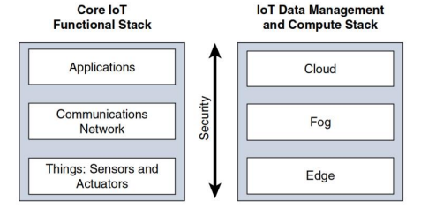
Cont..
SIMPLIFIED ARCHITECTURE
The fundamental building blocks that are common to most IoT systems and which is intended to help you in designing an IoT network.
This framework is presented as two parallel stacks.

Slide 58
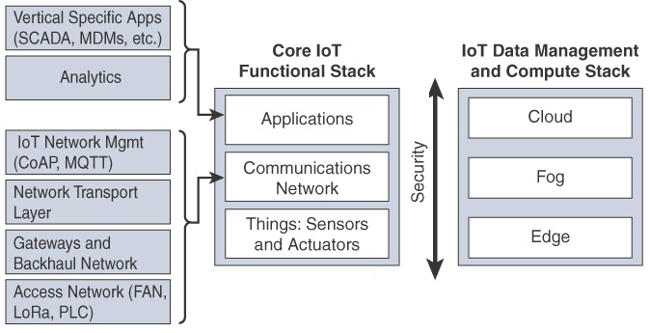
Cont..
SIMPLIFIED ARCHITECTURE

Slide 59
Cont..
SIMPLIFIED ARCHITECTURE
The Core IoT Functional Stack:
The core IoT functional stack consists of 3 layers. They are:
1. Things layer
2. Communications network layer
3. Applications layer
1.Things layer:
At this layer, the physical devices need to fit the constraints of the environment in which they are deployed.
Smart objects can be classified as:
a)Battery powered or power-connected

Slide 60
Cont..
SIMPLIFIED ARCHITECTURE
1.Things layer:
Smart objects can be classified as:
b)Mobile or static
c)Low or high reporting frequency
d)Simple or rich data
e)Report range
f)Object density per cell
2.Communications network layer:
When smart objects are not self constrained, they need to communicate with an external system
a) Access network sublayer
b)Gateways and backhaul network
c)Network transport and IoT network management

Slide 61
Cont..
SIMPLIFIED ARCHITECTURE
3.Application & Analytics layer:
At higher layer, an application is responsible for processing the gathered data. Its role is not only to control the smart objects but also to make intelligent decisions based on the collected information
a)Analytics versus control application
b)Data versus network analytics

Slide 62
Cont..
SIMPLIFIED ARCHITECTURE
IoT data management and compute stack:
Data management is aligned with each of the 3 layers of the core IoT functional stack.
The three data management layers are the
1)Edge layer(data management with in the sensors themselves)
2)Fog layer(data management with in the gateways and transit network)
3)the cloud layer(data management with in the cloud or central data center)

Slide 63
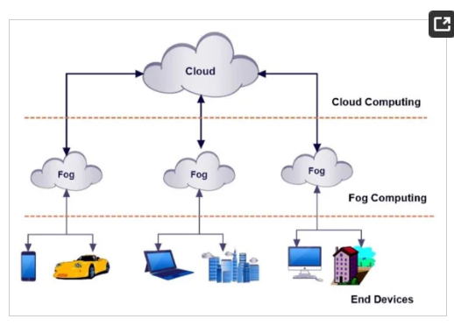
Cont..
FOG COMPUTING

Slide 64
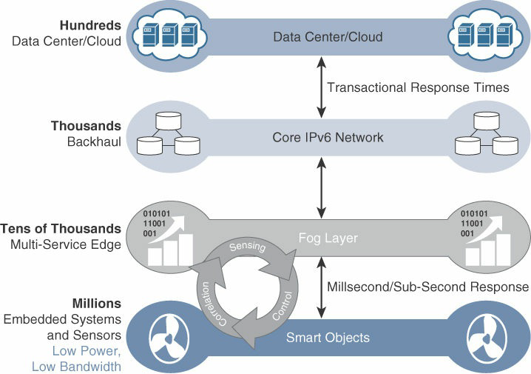
Cont..
FOG COMPUTING

Slide 65
Cont..
FOG COMPUTING
To distribute data management throughout the IoT system, as close to the edge of the IP network as possible.
The best-known. embodiment of edge services in IoT is fog computing. Any device with computing, storage, and network connectivity can be a fog node. Examples include industrial controllers, switches, routers, embedded servers, and IoT gateways.
Analyzing IoT data close to where it is collected minimizes latency, offloads gigabytes of network traffic from the core network, and keeps sensitive data inside the local network.

Slide 66
Cont..
FOG COMPUTING
Characteristics of fog computing:
Contextual location awareness and low latency
Geographic distribution
Deployment near IoT endpoints
Wireless communication between the fog and the IoT endpoint
Use for real-time interactions
Applications of fog computing:
It can be used to monitor and analyze the patients condition. In case of emergency, doctors can be alerted.
It can be used for real-time rail monitoring as for high-speed trains we want as little latency as possible.

Slide 67
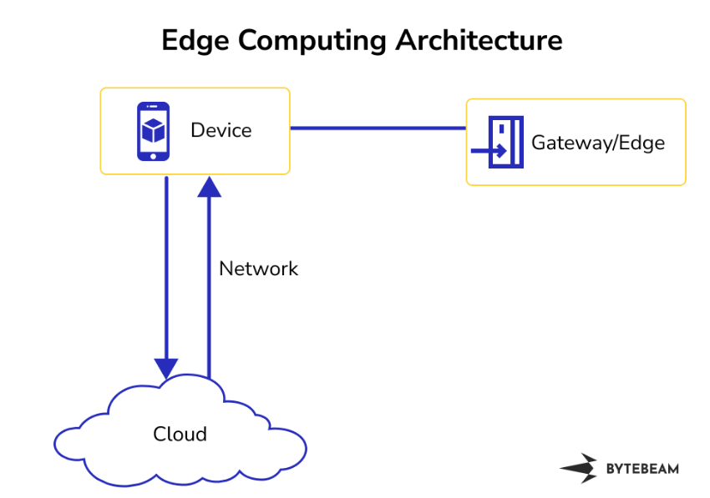
Cont..
EDGE COMPUTING

Slide 68
Cont..
EDGE COMPUTING
Characteristics of edge computing:
Proximity to data sources
Low latency
Bandwidth efficiency
Resilience and reliability
Security
Applications of edge computing:
Smart phones
Automation vehicles
Health care
Smart cities

Slide 69
Cont..
CLOUD COMPUTING
It provides us the means by which we can access applications as utilities over the internet. Cloud means something which is present in remote locations.
Cloud computing technology provides a variety of services that are classified into three groups:
1.SaaS
2.PaaS
3.IaaS
Advantages of cloud computing:
Improved performance - faster communication between IoT sensors and data processing systems.

Slide 70
Cont..
CLOUD COMPUTING
Advantages of cloud computing:
Storage Capacity - Highly scalable and unlimited storage space can integrate, aggregate, and share huge data.
Processing Capabilities - Remote data centers provide unlimited virtual processing capabilities on demand.
Low Cost - The license fee is less than the cost of on-premises equipment and its ongoing maintenance.
Disadvantages of cloud computing:
High latency
Downtimes
Security and Privacy
cloud providers:
Amazon web services, Microsoft Azure, Google cloud, IBM cloud, Oracle cloud infrastructure

Slide 71
Cont..
CLOUD COMPUTING
Advantages of cloud computing:
Storage Capacity - Highly scalable and unlimited storage space can integrate, aggregate, and share huge data.
Processing Capabilities - Remote data centers provide unlimited virtual processing capabilities on demand.
Low Cost - The license fee is less than the cost of on-premises equipment and its ongoing maintenance.
Disadvantages of cloud computing:
High latency
Downtimes
Security and Privacy
cloud providers:
Amazon web services, Microsoft Azure, Google cloud, IBM cloud, Oracle cloud infrastructure

Slide 72
Cont..
FUNCTIONAL BLOCKS OF AN IoT ECOSYSTEM
The logical design of IoT explains the conceptual representation of various components and entities within an IoT system.
The logical design focuses on the functional aspects of the IoT solution.
Logical design of IoT contains the following parameters.
1)IoT functional block diagram
2)Communication models used in IoT
3)Communication APIs.
Functional blocks:
IoT systems are composed of a number of building blocks, including sensors/actuators, connectivity, security, services, etc.
The functional blocks are responsible for sensing, verification, actuation, management, and communication.

Slide 73
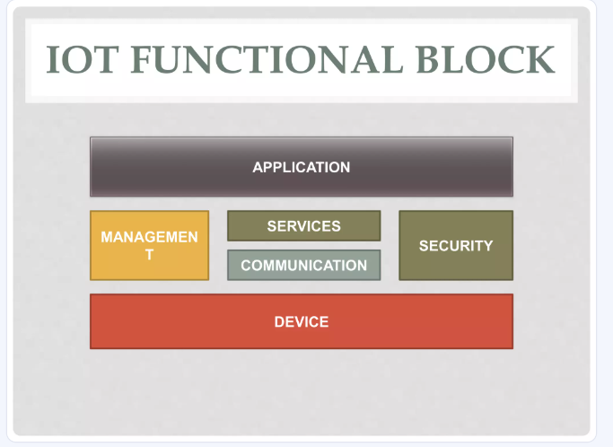
Cont..
FUNCTIONAL BLOCKS OF AN IoT ECOSYSTEM

Slide 74
Cont..
FUNCTIONAL BLOCKS OF AN IoT ECOSYSTEM
Device:
In an IoT system, devices are hardware components with sensors and actuators that enable them to sense the environment, collect data, and perform actions based on that data.
Communication:
The communication block is a critical component of an IoT system responsible for managing the exchange of data and information between the various devices and the central system or cloud.
Services:
IoT system uses various types of IoT services such as services for device monitoring, device control services, data publishing services, and services for device discovery.

Slide 75
Cont..
FUNCTIONAL BLOCKS OF AN IoT ECOSYSTEM
Management:
The management functional block in an IoT system encompasses a set of functions that oversee and regulate the overall operation of the IoT ecosystem.
Security:
The security functional block is responsible for safeguarding the IoT system from potential threats and unauthorized access.
Application:
IoT applications serve as the user interface for interacting with the IoT system.
Advantages:
Scalability
Interoperability
Modularity
Flexibility

Slide 76
Cont..
SENSORS
Sensor:
Sensor does exactly as its name indicates: It senses.
More specifically, a sensor measures some physical quantity and converts that measurement reading into a digital representation.
That digital representation is typically passed to another device for transformation into useful data that can be consumed by intelligent devices or humans.

Slide 77
Cont..
SENSORS
Types:
Active or passive: Sensors can be categorized based on whether they produce an energy output and typically require an external power supply (active) or whether they simply receive energy and typically require no external power supply (passive).
Invasive or non-invasive: Sensors can be categorized based on whether a sensor is part of the environment it is measuring (invasive) or external to it (non-invasive).
Contact or no-contact: Sensors can be categorized based on whether they require physical contact with what they are measuring (contact) or not (no-contact).
Absolute or relative: Sensors can be categorized based on whether they measure on an absolute scale (absolute) or based on a difference with a fixed or variable reference value (relative).

Slide 78
Cont..
SENSORS
Types:
Area of application: Sensors can be categorized based on the specific industry or vertical where they are being used.
How sensors measure: Sensors can be categorized based on the physical mechanism used to measure sensory input (for example, thermoelectric, electrochemical, piezoresistive, optic, electric, fluid mechanic, photoelastic).
What sensors measure: Sensors can be categorized based on their applications or what physical variables they measure.

Slide 79
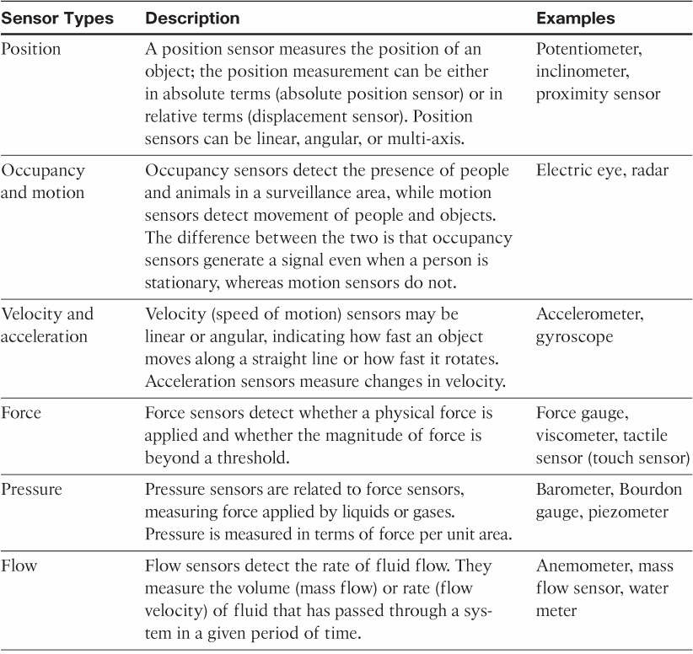
Cont..
SENSORS

Slide 80
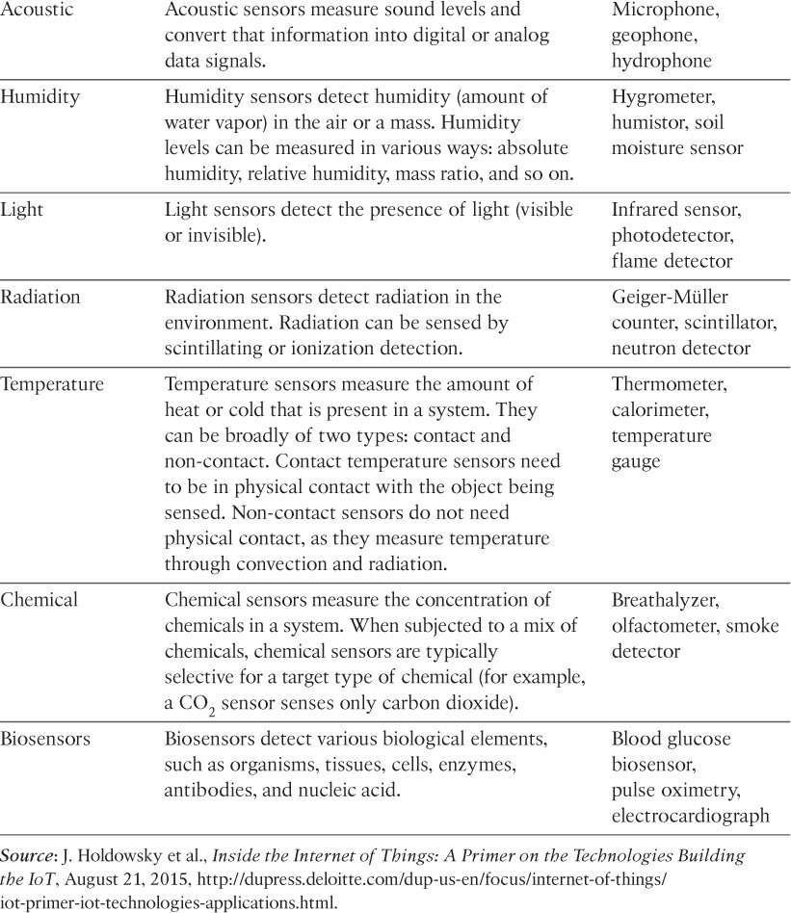
Cont..
SENSORS

Slide 81
Cont..
ACTUATORS
Actuators:
Actuators are natural complements to sensors.
An actuator is a mechanical or electromechanical device that transforms energy into motion.
In IoT, an actuators is responsible for the physical movement of an object.
For example, motors and heaters are some of the commonly used actuators.
For example, motors and heaters are some of the commonly used actuators
For example, motors and heaters are some of the commonly used actuators.
For example, heaters are some of the commonly used actuators.

Slide 82
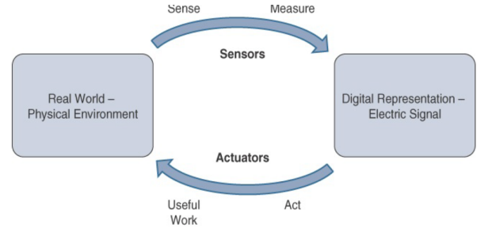
Cont..
ACTUATORS

Slide 83
Cont..
ACTUATORS
Sensors are designed to sense and measure practically any measurable variable in the physical world.
They convert their measurements (typically analog) into electric signals or digital representations that can be consumed by an intelligent agent (a device or a human).
Actuators, on the others hand, receive some type of control signal (commonly an electric signal or digital command) that triggers a physical effect, usually some type of motion, force, and so on

Slide 84
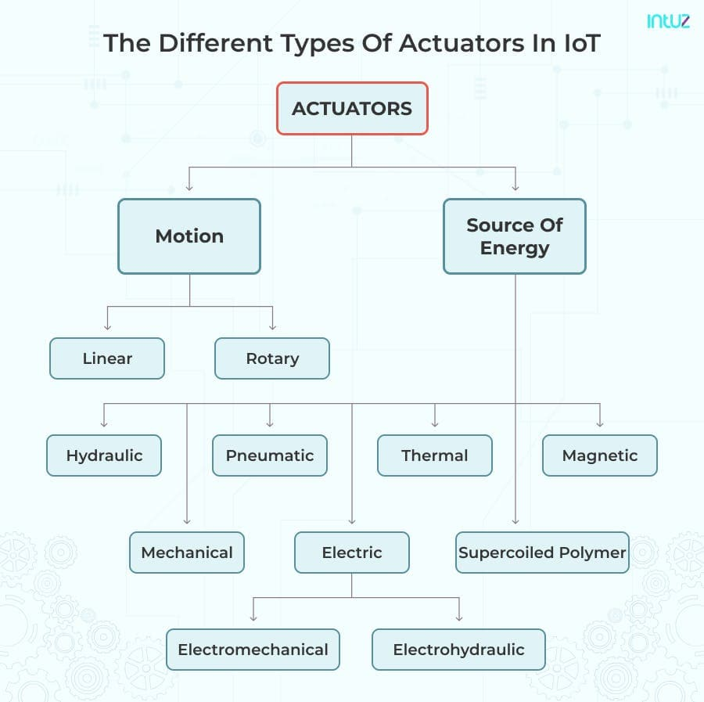
Cont..
ACTUATORS

Slide 85
Cont..
SMART OBJECTS
“The Building Blocks of IoT”.
Smart objects are physical devices embedded with computing capabilities, sensors, actuators, and communication modules. They are designed to:
1.Sense their environment (e.g., temperature, motion, light).
2.Process data using embedded intelligence.
3.Actuate changes in their environment based on conditions (e.g., turning on lights).
4.Communicate with other devices or systems.

Slide 86
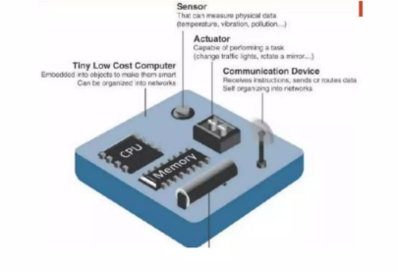
Cont..
SMART OBJECTS

Slide 87
Cont..
SMART OBJECTS
Characteristics of smart objects:
Processing unit.
Sensor(s) or actuator(s)
Communication device
Power source
trends in smart objects:
Size is decreasing
Power consumption is decreasing
Processing power is increasing
Communication capabilities are improving
Communication is being increasingly standardized.

Slide 88
Cont..
IOT PLATFORTI OVERVIEW
ARM Processors:
In technical terms, “ARM” stands for “Advanced RISC Machine.” It is a type of RISC (“Reduced Instruction Set Computer”) architecture that is becoming increasingly relevant in the modern world.
The ARM Cortex processor series is a family of central processing units (CPUs) designed by ARM Holdings (now part of Arm Limited) that are widely used in embedded systems, IoT devices, mobile phones, and high-performance computing.
These processors are known for their energy efficiency, high performance, and flexibility in design, making them a standard choice for modern embedded applications.

Slide 89
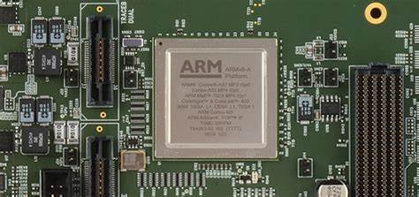
Cont..
IOT PLATFORTI OVERVIEW

Slide 90
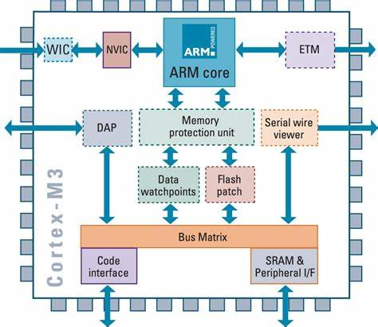
Cont..
IOT PLATFORTI OVERVIEW

Slide 91
Cont..
IOT PLATFORTI OVERVIEW
Families of ARM Cortex Processors
Cortex-M:
Optimized for low-power and low-cost embedded applications.
Commonly used in IoT, wearables, and consumer electronics.
Examples: Cortex-M0, M3, M4, M7.
Cortex-A:
High-performance application processors.
Found in mobile devices, tablets, and servers.
Examples: Cortex-A53, A76, A78.
Cortex-R:
Real-time processors for high reliability and deterministic performance.
Used in automotive systems (e.g., ABS, airbags) and robotics.
Examples: Cortex-R5, R8.

Slide 92
Cont..
IOT PLATFORTI OVERVIEW
Key Features of ARM Cortex Processors:
Energy Efficiency:
Optimized for low power consumption, ideal for battery-operated devices.
Scalable Architecture:
Divided into multiple families to meet various performance and application requirements:
Cortex-M: For microcontrollers and embedded applications (low power, real-time operations).
Cortex-A: For application processors in smartphones, tablets, and high-end embedded systems.
Cortex-R: For real-time computing applications like automotive and industrial systems.

Slide 93
Cont..
IOT PLATFORTI OVERVIEW
Key Features of ARM Cortex Processors:
Rich Ecosystem:
Supported by extensive tools, software libraries, and an active developer community.
High Performance:
Features like SIMD (Single Instruction Multiple Data) for multimedia applications.
Multi-core configurations for parallel processing.
Security:
Arm Trust Zone provides a hardware-based security framework for separating secure and non-secure operations.
Support for Machine Learning:
Arm processors include enhancements for AI and ML workloads.

Slide 94
Cont..
IOT PLATFORTI OVERVIEW
Applications of ARM Cortex Processors:
Internet of Things (IoT):
Low-power Cortex-M processors are the backbone of IoT devices, providing efficient computation for sensors, actuators, and communication modules.
Mobile Devices:
Cortex-A processors power smartphones and tablets, offering high computational power for apps, gaming, and multimedia.
Automotive:
Cortex-R processors are used in automotive applications such as engine control units (ECUs) and advanced driver-assistance systems (ADAS).

Slide 95
Cont..
IOT PLATFORTI OVERVIEW
Applications of ARM Cortex Processors:
Consumer Electronics:
Found in devices like smart TVs, cameras, and gaming consoles.
Healthcare:
Power portable medical devices like glucose monitors, wearable health trackers, and imaging equipment.

Slide 96
Cont..
IOT PLATFORTI OVERVIEW
Advantages of ARM Cortex Processors
Low Cost:
Licensing the ARM architecture is cost-effective, making it accessible to a wide range of industries.
Wide Compatibility:
Works with multiple operating systems (e.g., Linux, Android, Free RTOS).
Customizability:
OEMs can adapt ARM designs to their specific needs.
Global Adoption:
A trusted choice across industries, with billions of devices shipped globally.

Slide 97
Cont..
IOT PLATFORTI OVERVIEW
Future Trends
AI Integration:
Enhanced support for AI and ML applications using technologies like Arm NN and Cortex-A processors with ML enhancements.
5G and IoT:
Cortex processors are driving the next wave of IoT devices with 5G connectivity.
Sustainability:
Continued focus on ultra-low-power designs for energy-efficient computing.

Slide 98
Cont..
IOT PLATFORTI OVERVIEW
Aurdino Processors:
Arduino is an open-source electronics platform that uses microcontrollers as its core processing units.
These microcontrollers power Arduino boards, which are widely used for building electronic projects, prototypes, and educational purposes.
Arduino processors are selected for their ease of use, versatility, and compatibility with a variety of sensors and modules.

Slide 99
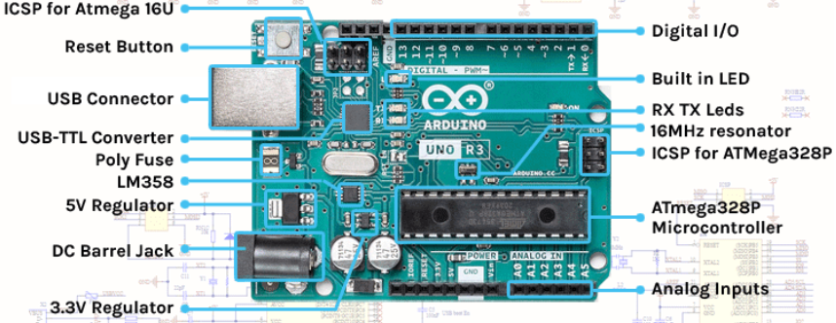
Cont..
IOT PLATFORTI OVERVIEW

Slide 100
Cont..
IOT PLATFORTI OVERVIEW
Common Arduino Boards and Their Processors:
Arduino Uno:
Processor: ATmega328P (8-bit AVR).
Features: 16 MHz clock speed, 32 KB Flash memory, and 2 KB RAM.
Applications: Basic DIY projects, beginner tutorials.
Arduino Mega:
Processor: ATmega2560 (8-bit AVR).
Features: More GPIO pins and memory than Uno, ideal for complex projects.
Applications: Robotics, large-scale projects.
Arduino Due:
Processor: SAM3X8E (32-bit ARM Cortex-M3).
Features: Higher performance, larger memory, and compatibility with advanced sensors.
Applications: Advanced robotics, IoT projects.

Slide 101
Cont..
IOT PLATFORTI OVERVIEW
Arduino Nano:
Processor: ATmega328P (8-bit AVR).
Features: Compact form factor, similar functionality to Uno.
Applications: Compact embedded systems.
Arduino Zero:
Processor: SAMD21 (32-bit ARM Cortex-M0+).
Features: Low-power operation, higher performance than 8-bit boards.
Applications: IoT devices, wearables.

Slide 102
Cont..
IOT PLATFORTI OVERVIEW
Applications of Arduino Boards:
DIY Electronics:
Creating custom gadgets like LED controllers, alarms, and temperature monitors.
Robotics:
Controlling motors, sensors, and actuators in robotic systems.
IoT (Internet of Things):
Connecting devices to the internet for automation and remote monitoring.
Education:
Teaching programming, electronics, and embedded system design.
Prototyping:
Quick development of functional prototypes for testing and demonstration.

Slide 103
Cont..
IOT PLATFORTI OVERVIEW
Advantages of Arduino Processors
Ease of Use:
Simple programming environment with extensive examples and libraries.
Wide Range of Boards:
Boards for every application, from simple projects to advanced systems.
Cost-Effective:
Affordable boards and components make Arduino accessible to everyone.
Active Community:
A large online community offers tutorials, support, and open-source projects.
Open Source:
Hardware and software are open-source, allowing customization and modification.

Slide 104
Cont..
IOT PLATFORTI OVERVIEW
Future Trends in Arduino Processors
Integration of AI:
Boards with AI capabilities like the Arduino Nano 33 BLE Sense for real-time machine learning.
Advanced Connectivity:
Processors with built-in Wi-Fi, Bluetooth, and LoRa for IoT applications.
Low-Power Design:
Focus on energy-efficient processors for wearable and portable devices.
Improved Processing Power:
Adoption of ARM Cortex-M processors for handling complex computations.

Slide 105
Cont..
IOT PLATFORTI OVERVIEW
Intel Galileo Boards:
The Intel Galileo boards are development boards designed for makers, hobbyists, and IoT developers.
They combine the power of Intel’s x86 architecture with the flexibility of Arduino-compatible hardware, making them versatile for a wide range of applications.

Slide 106
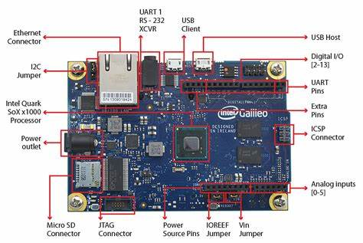
Cont..
IOT PLATFORTI OVERVIEW

Slide 107
Cont..
IOT PLATFORTI OVERVIEW
Key Features of Intel Galileo Boards:
Intel Architecture:
Powered by Intel Quark SoCs, which are x86-compatible processors.
Offers more computational power compared to traditional microcontrollers.
Arduino Compatibility:
Fully compatible with Arduino shields and the Arduino IDE.
Enables developers to leverage the extensive Arduino ecosystem.
Linux-Based OS Support:
Runs lightweight Linux distributions, enabling advanced applications requiring multitasking and networking.
Connectivity Options:
Includes Ethernet, USB, PCIe, and GPIOs.
Expansion slots for SD cards and mini-PCIe.
Robust Design:
Built for IoT prototyping with rich connectivity and high performance.

Slide 108
Cont..
IOT PLATFORTI OVERVIEW
Versions of Intel Galileo Boards
Intel Galileo Gen 1:
Processor: Intel Quark SoC X1000 (32-bit, single-core, 400 MHz).
Features: 256 MB RAM, Ethernet, microSD slot, and USB host support.
Focus: Entry-level prototyping.
Intel Galileo Gen 2:
Processor: Intel Quark SoC X1000 (32-bit, single-core, 400 MHz).
Features: Improved GPIO performance, PWM support, UART, and USB OTG.
Focus: Enhanced connectivity and faster GPIO operations.

Slide 109
Cont..
IOT PLATFORTI OVERVIEW
Versions of Intel Galileo Boards
Intel Galileo Gen 1:
Processor: Intel Quark SoC X1000 (32-bit, single-core, 400 MHz).
Features: 256 MB RAM, Ethernet, microSD slot, and USB host support.
Focus: Entry-level prototyping.
Intel Galileo Gen 2:
Processor: Intel Quark SoC X1000 (32-bit, single-core, 400 MHz).
Features: Improved GPIO performance, PWM support, UART, and USB OTG.
Focus: Enhanced connectivity and faster GPIO operations.

Slide 110
Cont..
IOT PLATFORTI OVERVIEW
Applications of Intel Galileo Boards
Internet of Things (IoT):
Prototyping IoT devices with Ethernet and cloud connectivity.
Industrial Automation:
Developing control systems for machines and industrial processes.
Smart Home Projects:
Automating home appliances and monitoring systems.
Education:
Teaching advanced computing concepts and embedded system design.
Prototyping Complex Systems:
Ideal for projects requiring high computing power or Linux-based development.

Slide 111
Cont..
IOT PLATFORTI OVERVIEW
Advantages of Intel Galileo Boards
Powerful Processing:
x86 architecture allows for more advanced applications compared to traditional microcontrollers.
Rich Connectivity:
Features like Ethernet and USB make it suitable for networked devices.
Arduino Ecosystem:
Compatible with Arduino libraries, shields, and programming environment.
Flexible Software:
Can run complex applications using a Linux-based operating system.
Prototyping for Intel-based Systems:
Ideal for creating prototypes that can scale to Intel architecture in production.

Slide 112
Cont..
IOT PLATFORTI OVERVIEW
Limitations of Intel Galileo Boards
Cost:
More expensive compared to basic Arduino boards.
Power Consumption:
Higher power requirements than traditional microcontrollers.
Learning Curve:
Slightly more complex to use than simpler microcontroller-based boards.
Discontinuation:
Intel discontinued the Galileo series in 2017, making it harder to find new units.

